Slide 1
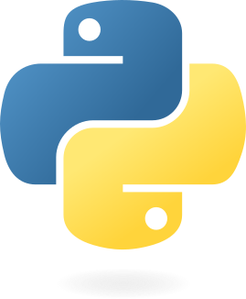


Python programming for the movement sciences
Philippe C. Dixon^{1,2}, Jill Emmerzaal¹, Clint Hansen³, Robbin Romijnders³, Vaibhav Shah² ,
McGill University. Department of Kinesiology and Physical Education
University of Montreal. Biomedical Engineering Institute
Kiel University, Department of Neurology

Slide 2
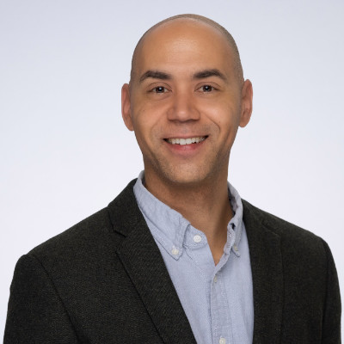
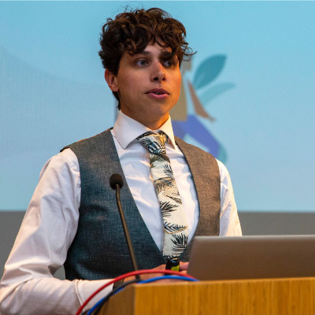
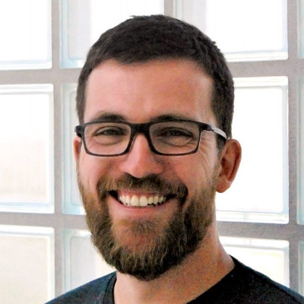
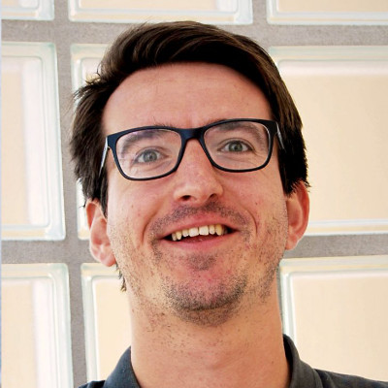

Python programming for the movement sciences
Meet the team
Jill Emmerzaal
Phil Dixon
Jill Emmerzaal
Clint Hansen
Robbin Romijnders
Vaibhav Shah

Slide 3
Seminar overview
What to expect
Schedule
08:30-08:35 General Introduction to the seminar (P. Dixon)
08:35-09:15 Introduction to Python (J. Emmerzaal)
09:15-09:45 Python toolboxes for marker-based motion capture (P. Dixon)
09:45-10:20 Python toolboxes for sensor-based capture (R. Romijnders)
10:20-10:30 AI coding assistants (V. Shah)
10:30-11:00 Coffee break
11:00-12:00 Practical hands-on session / Questions-Answers

Slide 4
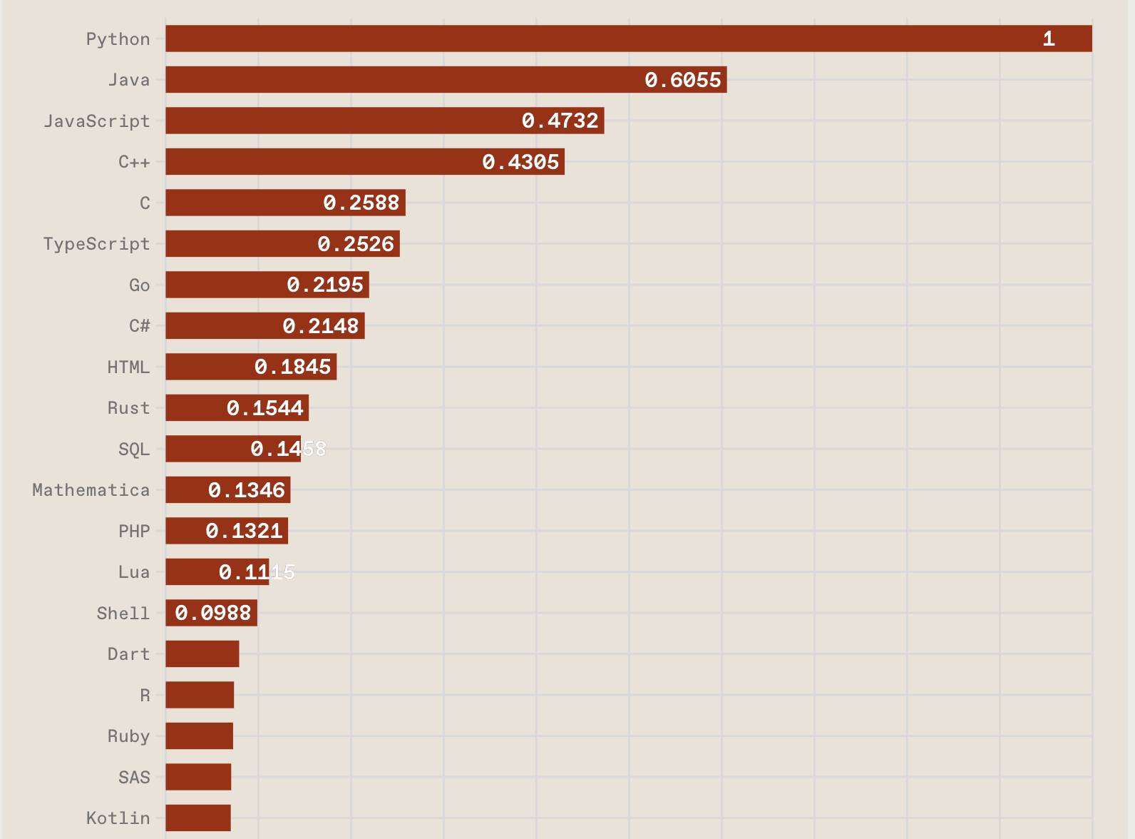
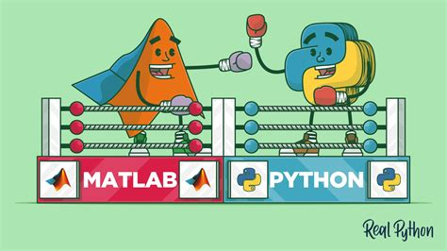
Why learn Python?
Python is trending, but does it live up to the hype?
https://spectrum.ieee.org/top-programming-languages-2024
https://realpython.com/matlab-vs-python/

